Slide 1
What is “Humanics?”
The Oxford English Dictionary defines Humanics as, “the subject or study of human affairs or relations, especially of the human element of a problem or situation as opposed to the mechanical.”
Why might we want to study this?

Slide 2
Read This!
A New Bionic Eye Could Give Robots and the Blind 20/20 Vision

Slide 3
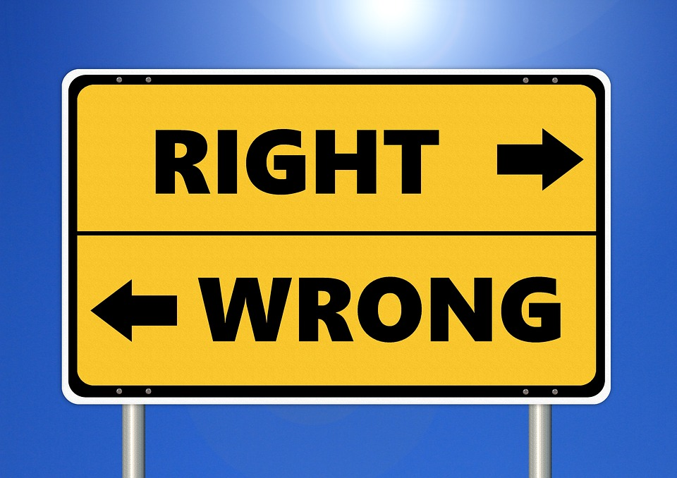
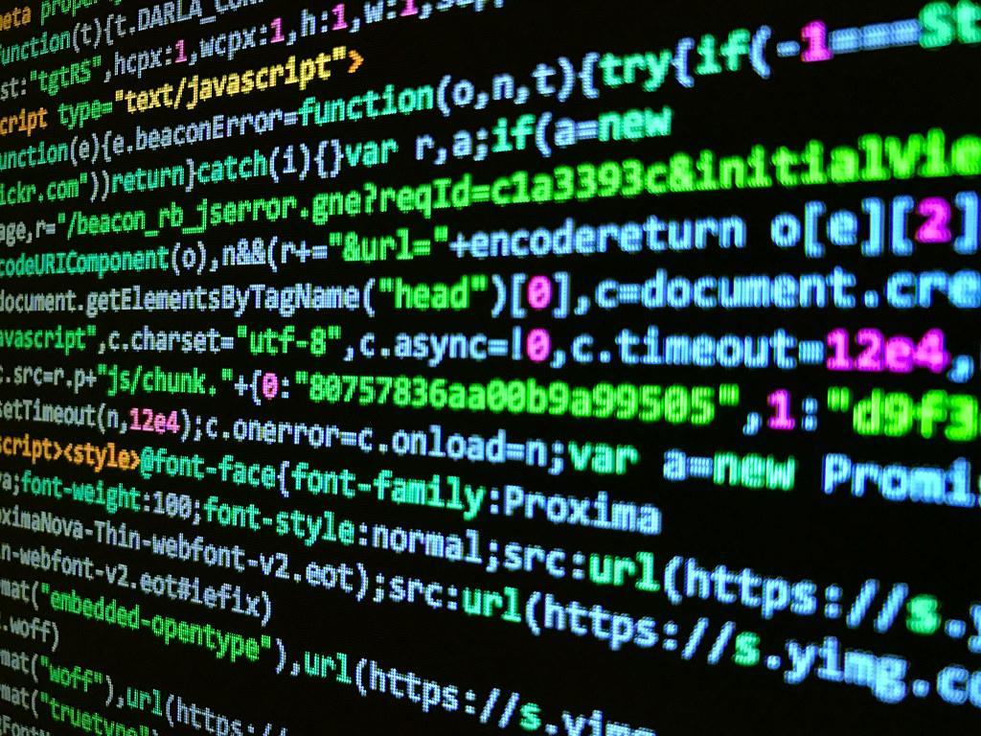
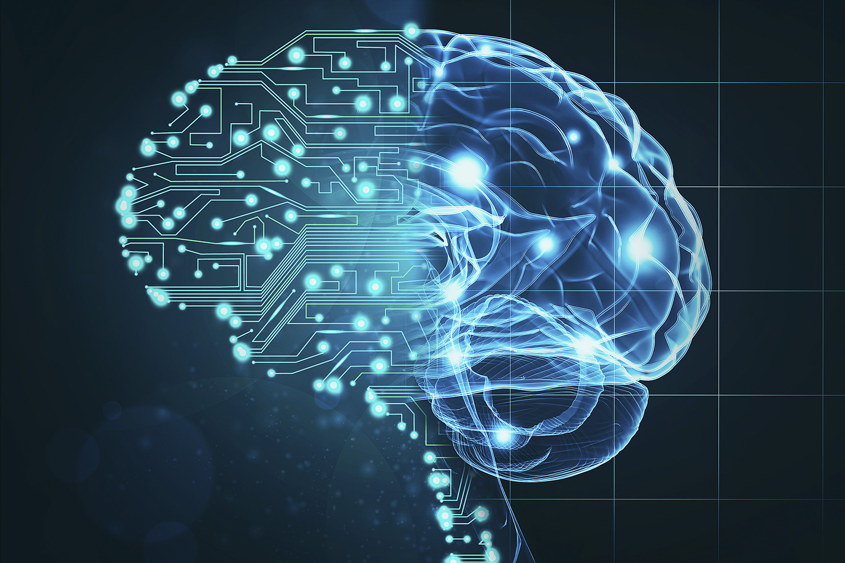
Virtue Ethics
From Human Moral Code
To Computer Code
To A.I. Moral Code
The primary question is this...what kind of moral or ethical code should we encode into a machine?

Slide 4



Which Human would you trust?
A. B. C.
Will punish those who do wrong and reward those who do right. Believes there is a right and a wrong.
Will always ask “why?” when making a choice. Believes in the gray. Does not believe in good or evil.
Will always choose the option that leads to the greatest good for the greatest number.

Slide 5
Construct your ethical code...remember this is your personal code. Try not to let others influence it!
Evil
Neutral
Good

Slide 6
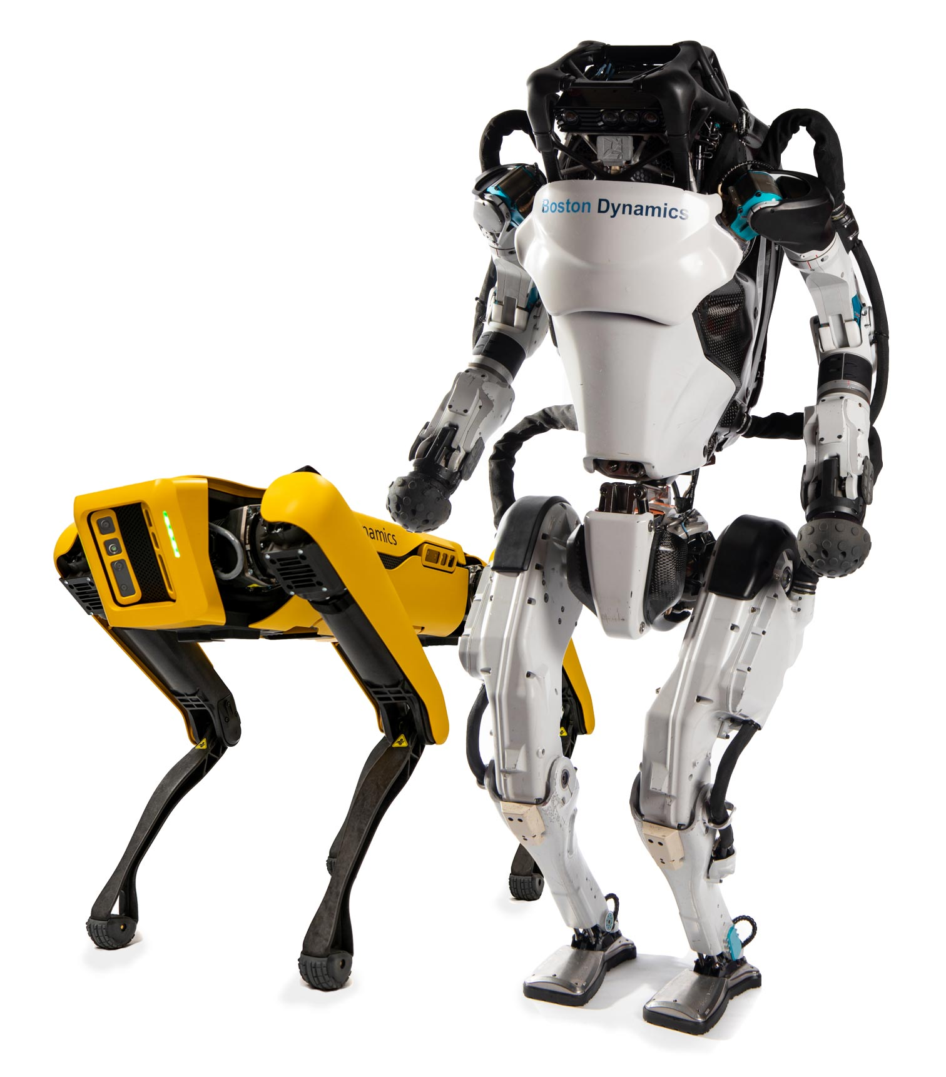
Which Robot would you trust?
A. B. C.
Will always choose the option that leads to the greatest good for the greatest number. Ex. Hires you because you are willing to be a slave for the company.
Will punish those who do wrong and reward those who do right. Believes there is a right and wrong. Ex. Hires you because you are NOT religious.
Will always ask “why?” when making a choice. Believes in the gray, not in good or evil. Ex. Hires you because your character is most likely going to help the company.

Slide 7
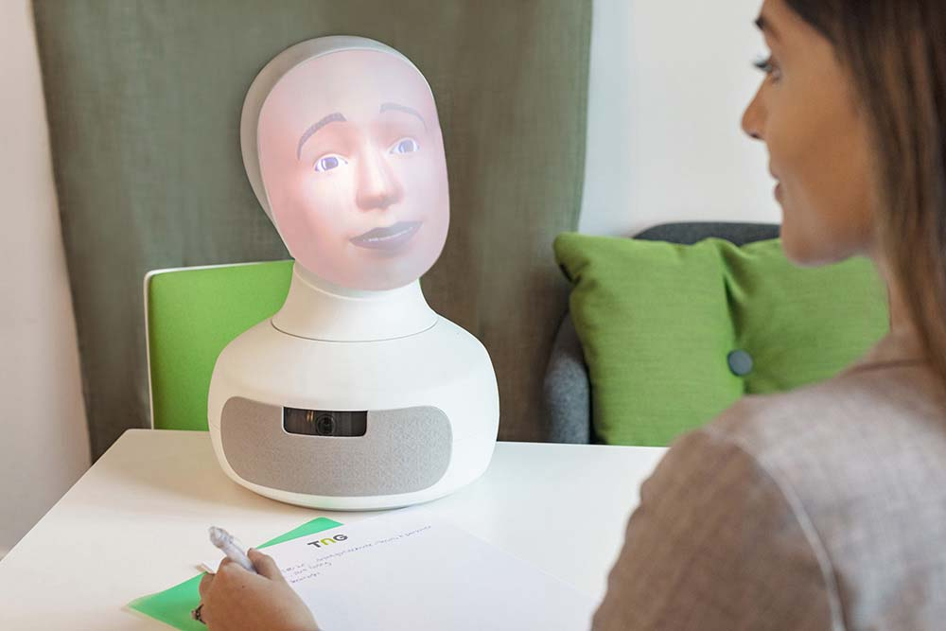
What does Robot C. really look like?
Meet Tengai - The Virtue Ethicist Robot

Slide 8

Quick Summary of Virtue Ethics

Slide 9
The Value of Humanics: 2nd Job Training
Will Your Job Be Done By A Machine?
Look up some jobs you are interested in…
What are the odds of them being automated?
Why do you think they have these odds?

Slide 10
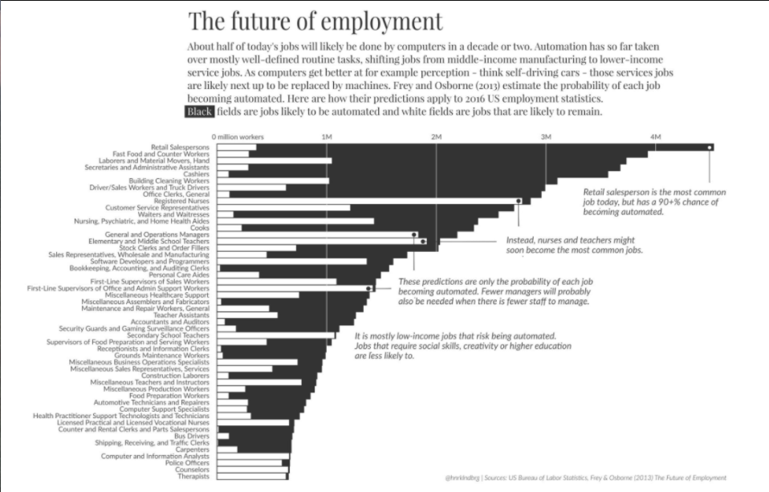

Slide 11
The Value of Humanics:
3rd Spiritual Enlightenment
& Government Transformation

